Slide 1
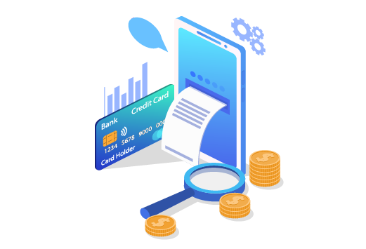
Quality Refresher

Slide 2
Billing:
Why bills increase
Billing Layout
IDA
IBA
Billing Cycles and Prorates
TC Policies & Appointment Discipline ($60 fee for technician visit).

Slide 3
Increases
There are some reasons why a bill could increase. - Changes on Suddenlink standard prices. - Upgrades that customers perform in their accounts. - Promotion Expired
One of the most common is because the customers Promotion expired.
Promotions are a way to provide customers an opportunity to enjoy what Optimum has to offer at a discounted price. They are usually good for a time period of 6 to 24 months, and they are renewed periodically until they reach the regular rate of the service.

Slide 4
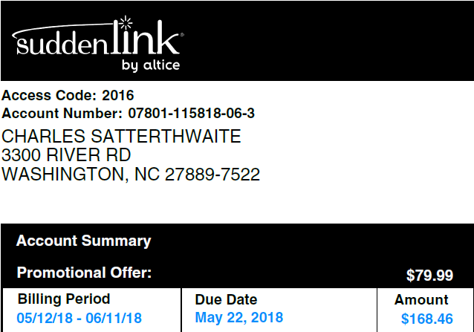
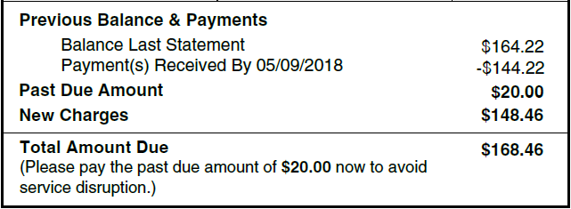
Know your bill

Slide 5
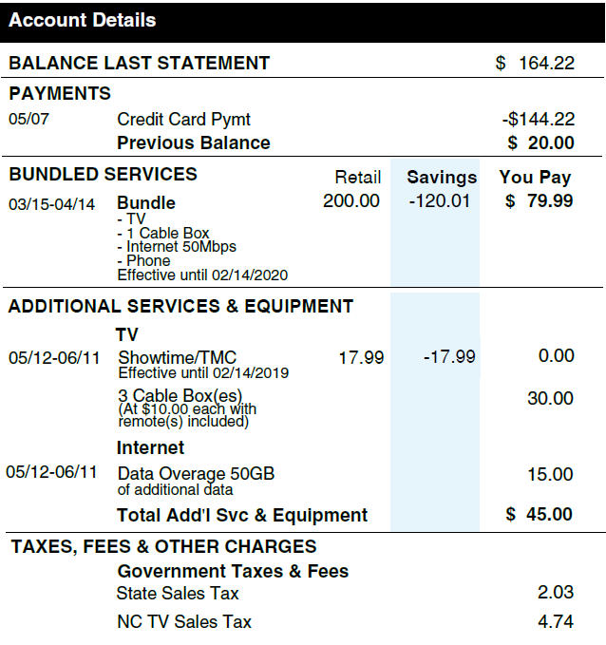
We can confirm when a promotion expired with a bill comparison Looking at the following section
Promotional discounts including the expiration dates and other benefits.
Taxes & Fees are distinctly and individually
displayed

Slide 6
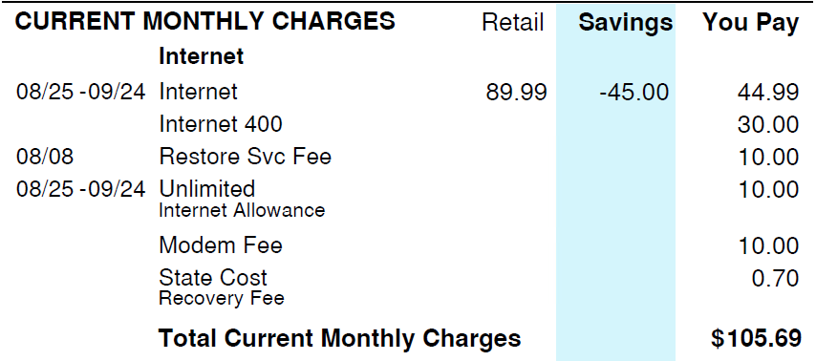
Current monthly charges
Here we can see the services including on the account before taxes, the services and features including on the account.
Modem fees.
Internet (which is the internet services that has include 100 MBPS which is our default speed).
Internet 400 which is an additional speed.
The state cost that is a fee of $0.70
Restore service fee (This is fee appears on this account because the services were interrupted for non-pay, even if the customer received an extension of the services, this fee would appear on each service that the customers have. Since this customer only has internet service, only one service, the fee will be $10.00. If the customer had had a tv, internet, and phone service, the restore service fee would have been $5.00 for each service.
Unlimited internet allowance –This service allows the customers to using their internet and download unlimited date.
Savings, We can see here the promotional amount that the customer received which is help to him to save monthly $45.00. In case that the customer requests to know when this promotion will be expired, we need to go to IDA –Products & Promos, so there we can see the exactly date when promotion will be expired. There you will be able to see the Start date (when the promotion starts and End date, which is when the promotion will end.

Slide 7
Balance last statement and payments
Basically we can see here the same information. However, we will see more details about payments. Example, the payment method that the customer used when he made the payment. In this case it was a Credit Card and the payment was for $303.56 and there was a remind balance of $121.57 because the total amount due for the previous bill was for $425.13.

Slide 8
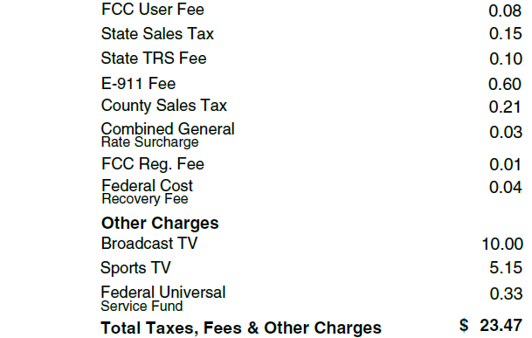
One-time activity and “Taxes, fees & other charges”

Slide 9
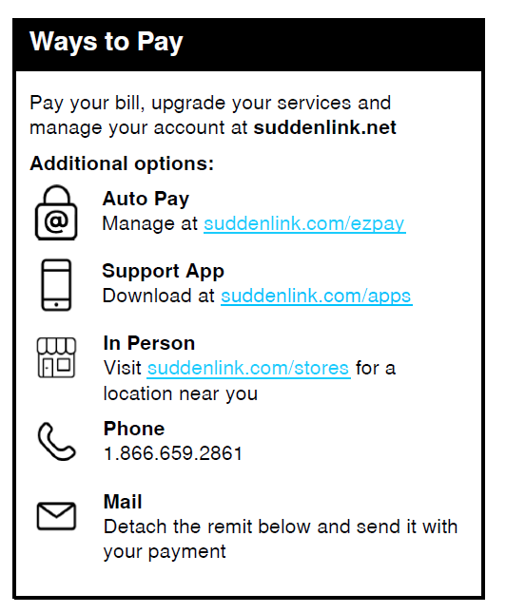
Ways to pay
Customer can make the payment using our Auto-payment method. The customer needs to enroll her/himself on EZ-pay.
The customer has the option to make the payment of the current balance using our apps *Suddenlink Support app”
Customer has the option to go to the near Suddenlink store and make the payment in person.
Using our IVR system, they just need to call us and IVR can take their payments.
Mail payments, they can send us payments via mail.

Slide 10
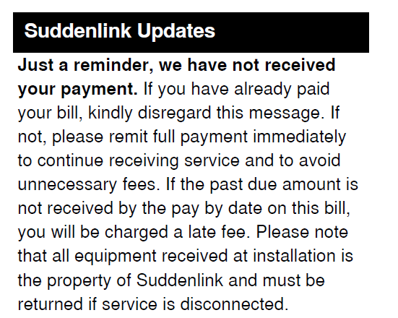
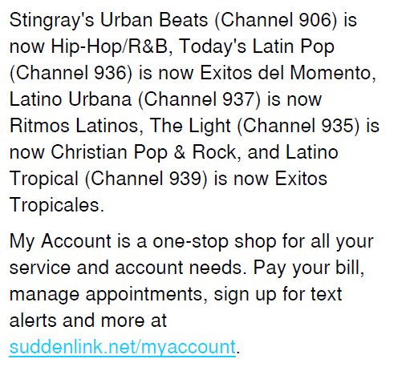
Suddenlink updates.

Slide 11
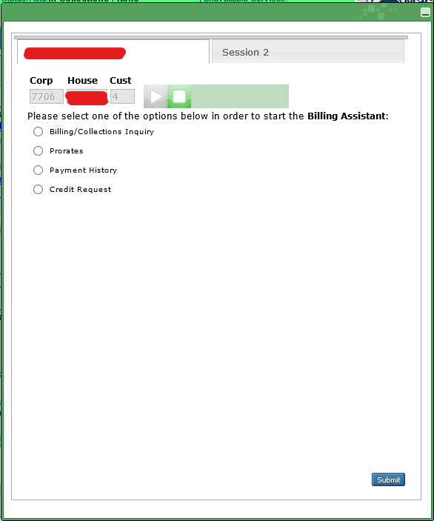
IBA use: This is our intelligent Billing assistant tool. With this tool we are able to verify all of the information relate to payments, past due balance, credit request, restore services, cancel non-payment disconnect order, apply credit for services interruption and late fee.

Slide 12
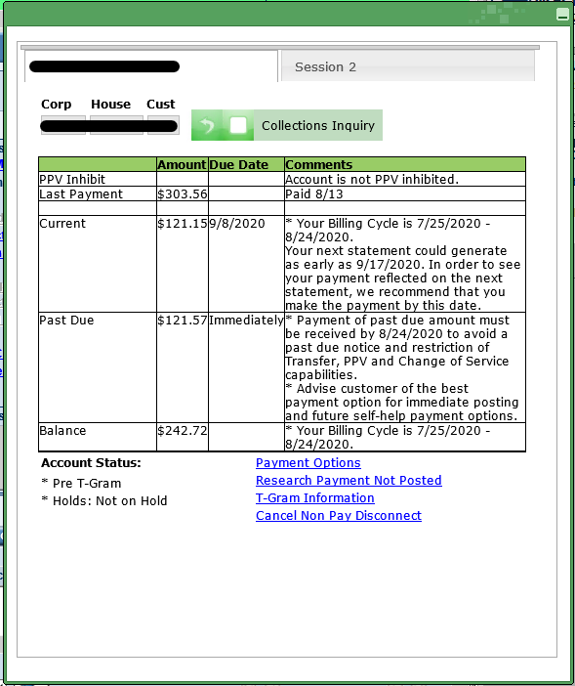
Billing/collections inquiry
We can see here the current amount.
Last payment that we received/customer did.
Past due amount.
Balance for the current month.
Billing cycle.
The cut-off day.
On account status:
We can see the payment options that the customer has. (We do not use this one)
Method for research payment that hasn’t been posted.
T-gran information/notification
Cancel Non-pay disconnect process.

Slide 13
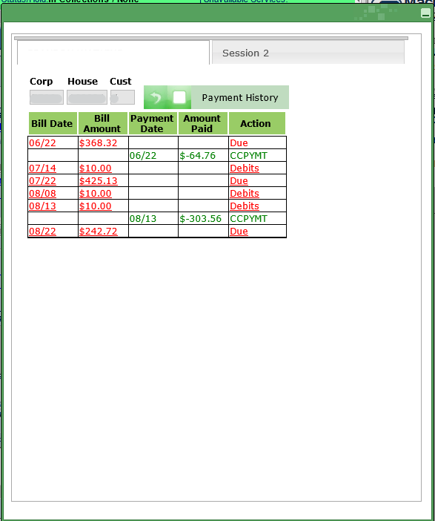
Payment History Here we can see the last three months payments activities.

Slide 14
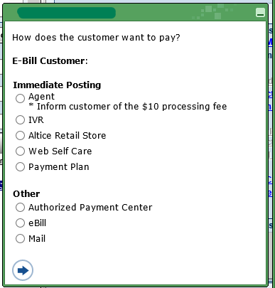
Payment options
So, we here we have different options that the customer has in order to make the payment.
If the customer wanted to make the payment with the rep, they will be charged with $10.00 extra. Only voice can take the payment.
With the IVR payment system over the phone.
The information of the Altice store..
Online payment.
Payment plan (we do not offer this one)
Other payment methods:
We see here APC.
E-bill.
Mail.

Slide 15
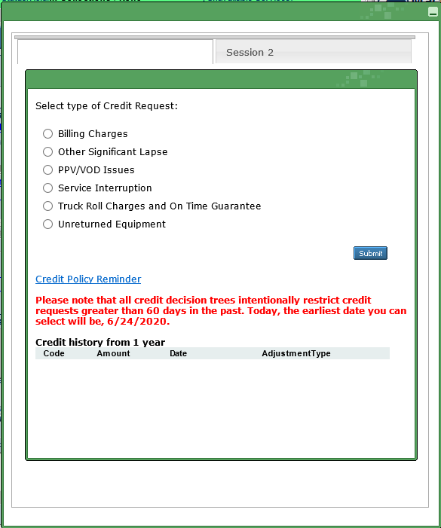
Credit request Here we can provide credit our customer with authorization of our supervisor, for late fees, services interruption, etc.

Slide 16
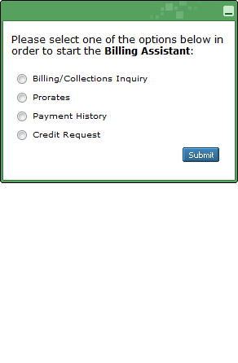
Prorated Charges & Billing Cycles.
Billing cycles are assigned depending on installations dates.

Slide 17
Prorated Charges & Billing Cycles.
Billing cycles are assigned depending on installations dates.
# of Days Charged or Credited for Rate Change
Total Amount Charged or Credited for Rate Change

Slide 18
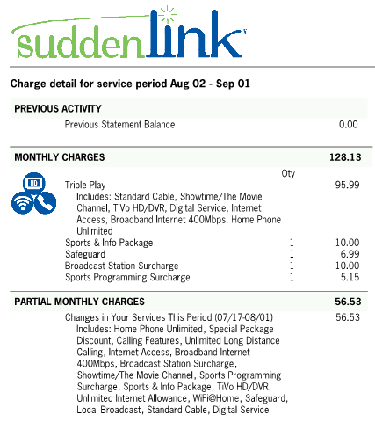
Prorate Example
Customer moved on 7/17 but their billing cycle does not begin until 8/2
The $56.53 charge is for services rendered between 7/17-8/1
This bill also includes a full month's charge of $128.13 to cover the following month of service (7/8 to 8/7)

Slide 19
TC Policies and Appointment Discipline.
When we talk about the TC Policies, we refer to the possible $60 fee for the trouble call.
The Appointment Discipline is related to advising a customer that someone over the age of eighteen needs to be home at the day of the visit.
We always need to inform the customer about the trouble call fee AND appointment discipline when scheduling an appoinment.
After Running MT or ITT This Screen will display

Slide 20
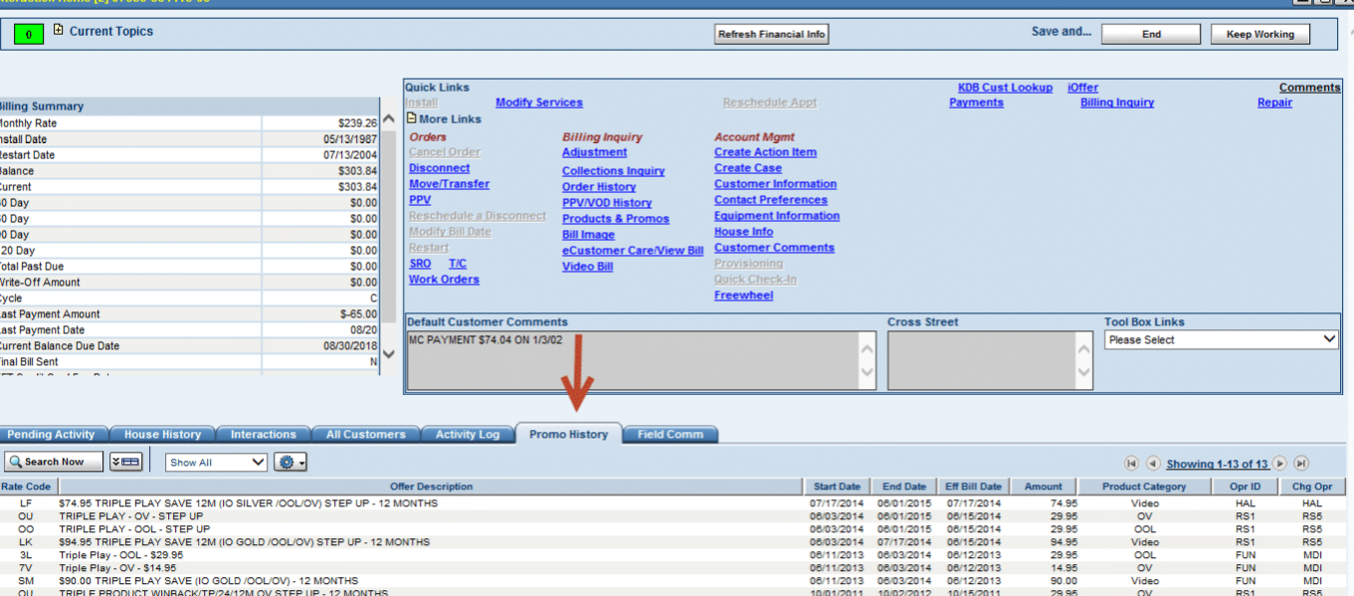
We can also view active and expired promotions in IDA on the Interactive Home Page under the Promo History Tab.

Slide 21
Service Protection Plan
Suddenlink’s Service protection plan provides customers with a worry-free experience by covering them from unexpected service visit fees.
The SP must be offered to the Account Holder and Authorized user (CPNI is not required to add it). It’s very important to always offer the service protection plan on the interaction when scheduling an appointment as this will avoid future billing complains about the $60 fee.
If customer’s account does not have service protection added and a fee is being applied, please go to IDA/House History and find the Complete appointment notation the TC code to confirm if the fee is applicable, for more information about chargeable TC Codes please visit KDB article ‘’List Of Trouble Call & SRO Codes’’.

